Slide 1

MITRE ATT&CK
&
IMPLEMENTING AN
ADVERSARY-FOCUSED FRAMEWORK
Notes:
Differ from traditional Cybersecurity Frameworks
Adversary Based
Describe attacker activities as a sequence of steps to meat their objectives like Destruction, Espionage, Exfiltration
Traditional detection mechanisms rely on static indicators of compromise
File Hashes, Domains, IPs

Slide 2


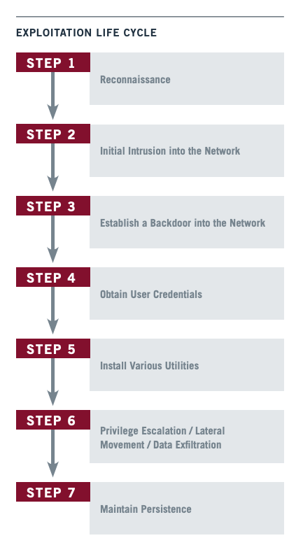
Notes:
2010 Mandiant, now part of FireEye introduced Exploitation life cycle

Slide 3
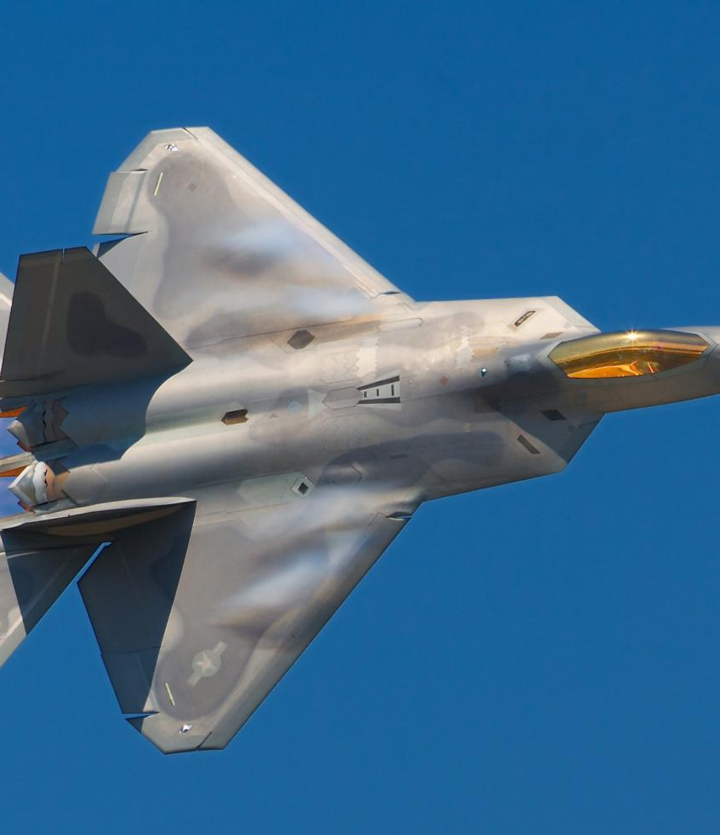
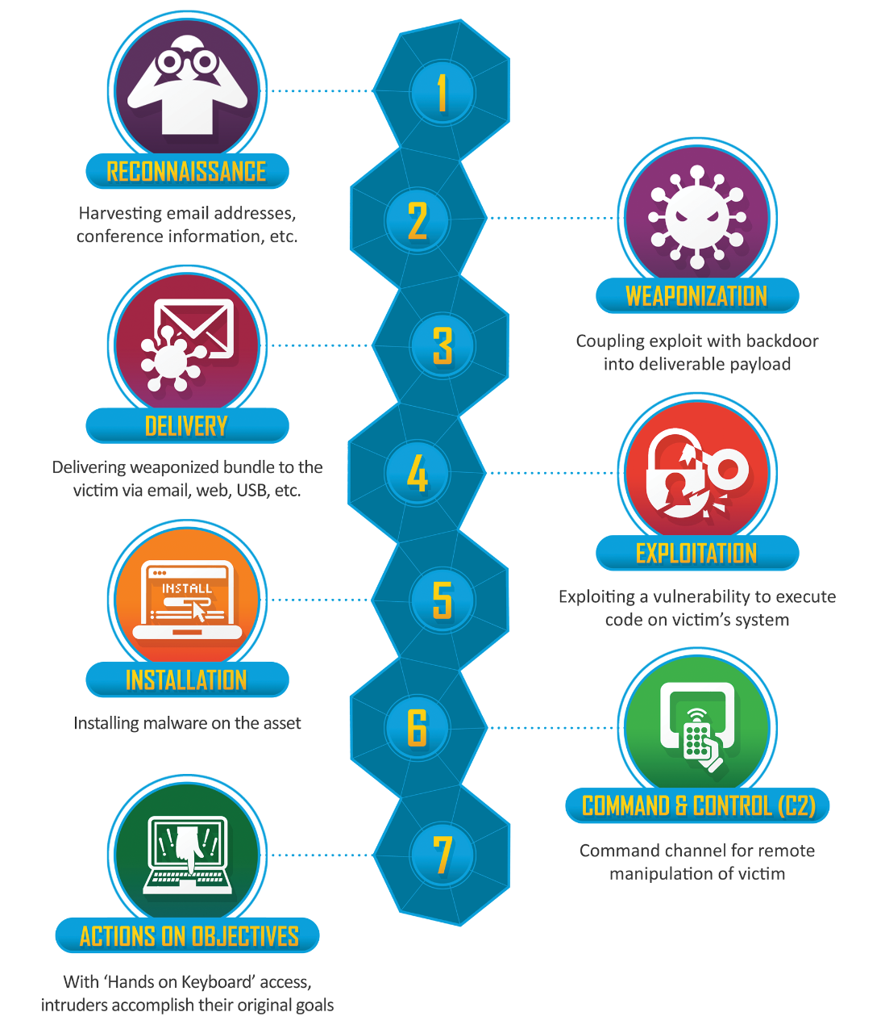
LM
CYBER KILL CHAIN
Notes:
Essentially Become Industry Standard
SANS has built an entire course on kill chain
Purple team course

Slide 4
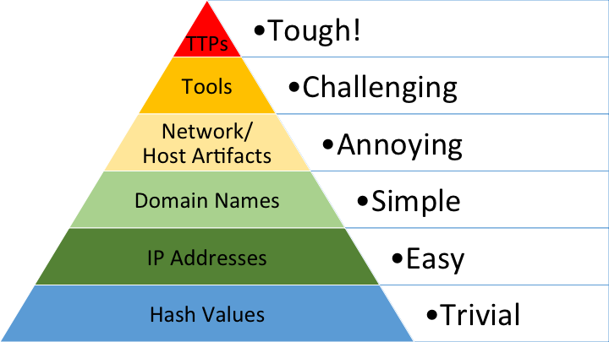
Dave Bianco’s Pyramid of Pain
Notes:
Network artifact could be user-agent
Host artifact – registry key value
Tool – mimikatz for credential dumping
TTPs –pass-the-hash attacks

Slide 5
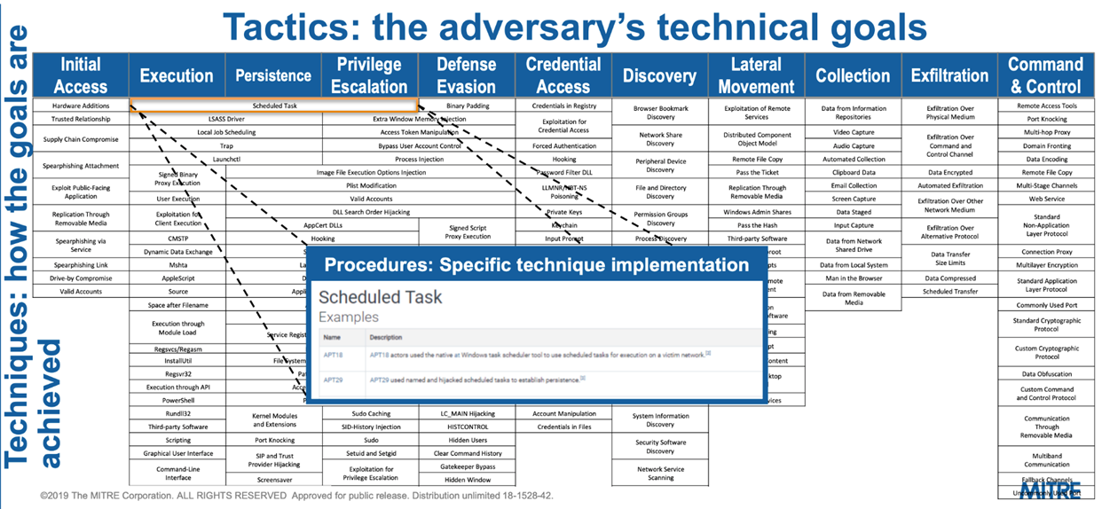
Notes:
Can be leveraged for:
Creating detection and prevention mechanisms
red or purple team exercises
Training for employees
performing evaluation of vendor EDR tools

Slide 6
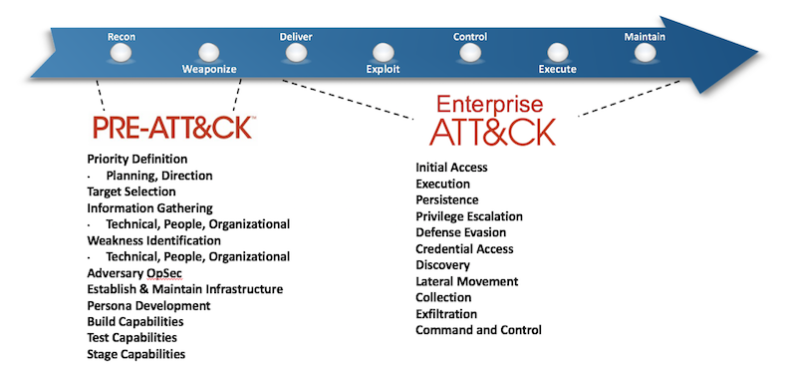
MITRE ATT&CK
&
Notes:
Enterprise Att&ck
Tactics > Techniques

